Slide 1


WEB BROWSERS AND WEB SERVERS
Srijan panta and utsuk paudayal

Slide 2

Web Browsers
Srijan Panta

Slide 3






Web Browser
Introduction
Architecture
Popular Browsers

Slide 4

Introduction
A web browser is a software program that allows a user to locate, access, and display web pages.
Browsers are used primarily for displaying and accessing websites on the internet.

Slide 5
Working/Architecture
Browsers translate web pages and websites delivered using Hypertext Transfer Protocol (HTTP) into human-readable content.
Components
Controller/Dispatcher
Interpreter
Client Programs
Http
SMTP
POP

Slide 6
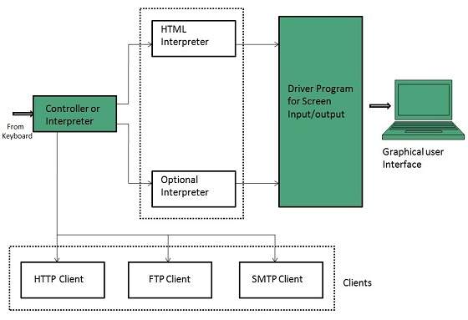

Slide 7
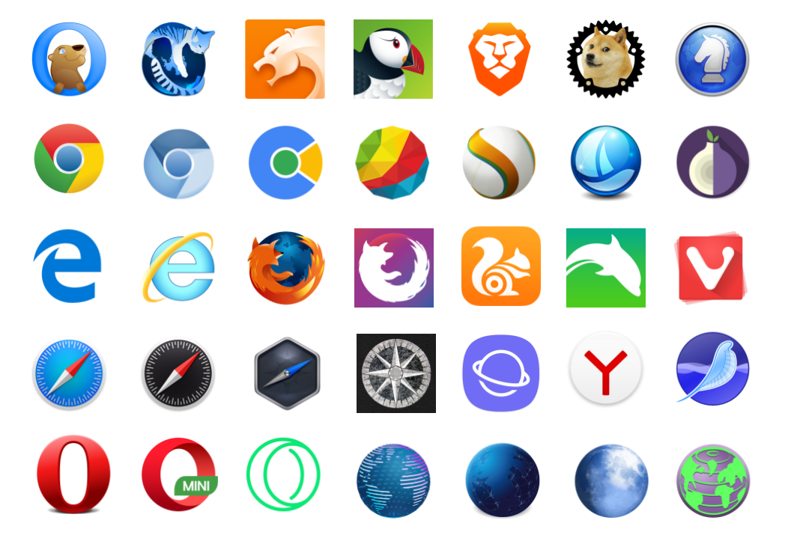
Examples Of Browsers

Slide 8
Web Browsers in early 1990s
WorldWideWeb (not World Wide Web) is the first web browser
Develoved by Tim berners lee in 1990
Later renamed to Nexus
Mosaic(1993) the first web browser to allow images
A noticeable improvement to Mosaic came Netscape Navigator.

Slide 9

Internet Explorer
Developed by Microsoft Windows
Published in 1995
Version 2, released in November, added support for secure sockets layer (SSL) encryption and cookies
Version 3 followed in August 1996 with Java and cascading style sheets (Css)

Slide 10
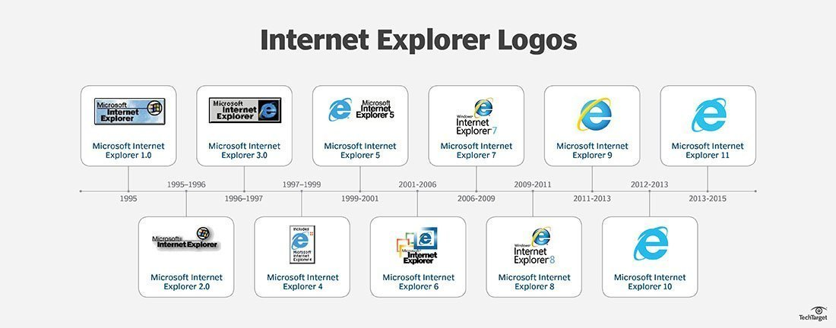
Development of Internet explorer logo

Slide 11
pera
Started research in 1994
Went public in 1996
Features of the Opera web browser include private browsing, tabbed browsing, download manager, mouse gestures and browser extensions
Now comes with in-build ad-blocker

Slide 12
Apple Safari
Web browser for Macintosh pc and iphones, ipads.
Pc version in 2003
Mobile version in 2007
Works with Webkit engine

Slide 13
Firefox
Free open source software
Developed in 2004
Based on Mozilla code
Supports various of functions

Slide 14
Google Chrome
Chromium based browser
Developed by Google in 2008
Most popular browser since establishment

Slide 15
Edge
New browser by Microsoft
Developed in 2015
Developed specially for windows 10
Fast and reliable

Slide 16





Browsers on the basis of popularity
Data by w3schools

Slide 17
Web Servers
Utsuk Paudayal

Slide 18
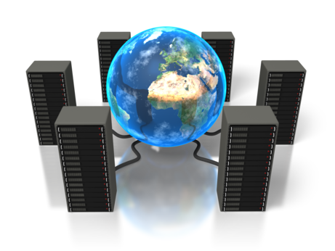
Introduction
Program that uses HTTP (Hypertext Transfer Protocol) to serve the files from Web pages to users, in response to their requests, which are forwarded by their computers' HTTP clients.
Any server that delivers an XML documents to another device can be a web server.
The files stored in web servers are read by browsers which convert these files into text and images for you to view.

Slide 19
cont..
A web server is always connected to the internet.
Every web server that connects to the internet will be having an unique address which contains a series of four numbers between 0 to 255.
Web server enables the hosting providers or host to manage multiple domains(users)on a single server.
A server can communicate and send the same file or the different files to the hundreds of the users at the same time.
Web servers typically runs on two types of OS. Linux or Microsoft windows. But most of the web servers today operate Linux and most websites are hosted on Linux servers.

Slide 20
Do you think that Web Server plays an important role in hosting ?

Slide 21
When is Web Server required ?
Generally, web servers are used by web hosting companies and professional web app developers. But, actually anyone who satisfies one of the below category can use it:
One who owns a website (to make the local copy on their system resemble what is on internet).
One who wants to use server-side technologies, such as, PHP or ColdFusion, can also use the web server.

Slide 22
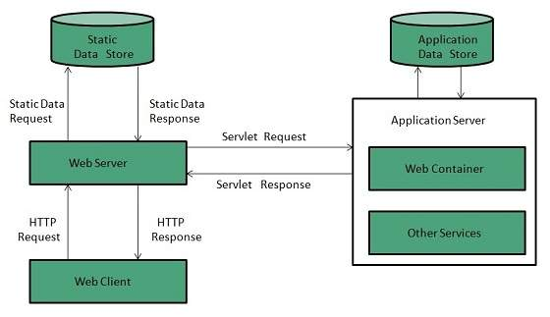
Working
A page on internet can be viewed, when the browser requests it from the web server and the web server responds with that page. A simple diagrammatic representation of this is as given below in the figure:

Slide 23
Simple process consists of 4 steps, they are:
Obtaining the IP Address from domain name: Our web browser first obtains the IP address the domain name (for e.g., www.geeksforgeeks.org) resolves to. It can obtain the IP address in 2 ways-
By searching in its cache.
By requesting one or more DNS (Domain Name System) Servers.
Note: Any website is assigned an IP address when it is first created on web server.
Browser requests the full URL : After knowing the IP Address, the browser now demands a full URL from the web server.
Web server responds to request: The web server responds to the browser by sending the desired pages, and in case, the pages do not exist or some other error occurs, it will send the appropriate error message. For example: Error 404, is the message sent by the server when the page does not exist. Another common one is Error 401 when access is denied to us due to incorrect credentials, like username or password, provided by us.
Browser displays the web page: The Browser finally gets the webpages and displays it, or displays the error message.

Slide 24

Different types of Web Servers
Apache(1995)
This is the most popular web server in the world developed by the Apache Software Foundation.
Apache web server is an open source software and can be installed on almost all operating systems like Linux, UNIX, Windows, Mac OS X and more.
About 60% of the web server machines run the Apache Web Server.
As it is open source, you can add your own modules to the server and make modifications according to your requirements.
More stable than any other web servers and is easier to solve administrative issues.

Slide 25

IIS (Internet Information Service)
Microsoft IIS (Internet Information Service) is the second most popularly used web server, and its market share is increasing quite rapidly with each passing day and is likely to overhaul Apache in the upcoming years.
IIS server has all the features just like Apache, but it is not open source. It is developed, and maintained by Microsoft, thus it works with all the Windows operating system platforms.

Slide 26

Nginx(2004)
NGINX is second on a list of open source web servers by usage, running just over 30% of all websites.
Nginx is a popular web server for its high performance, stability, simple configuration and low resource usage.
NGINX relies on an asynchronous event-driven architecture to help power its goal of handling massive concurrent sessions.
Released under a BSD-like license, and can not only be deployed as web server, but also as proxy server.

Slide 27

Apache Tomcat
Open source Java Servlet Container
Powers just 1% of all websites
Supports PHP and ASP.net
Typically used to run Java Programs

Slide 28

Lighttpd(2003)
Distributed under a BSD license.
Lighttpd distinguishes itself with its low memory footprint, small CPU load, and speed optimizations.
Powers 0.1% of all websites
optimized for a large number of parallel connections, and supports FastCGI, SCGI, Auth, Output-compression, URL-rewriting and many more features.

Slide 29
Unfortunately, there are still quite significant downsides to self-hosting your website:
Slow connections
Changing IP addresses
Costs a lot of electricity
Responsible for h/w & s/w maintenance.

Slide 30

Thank You!

